Slide 1
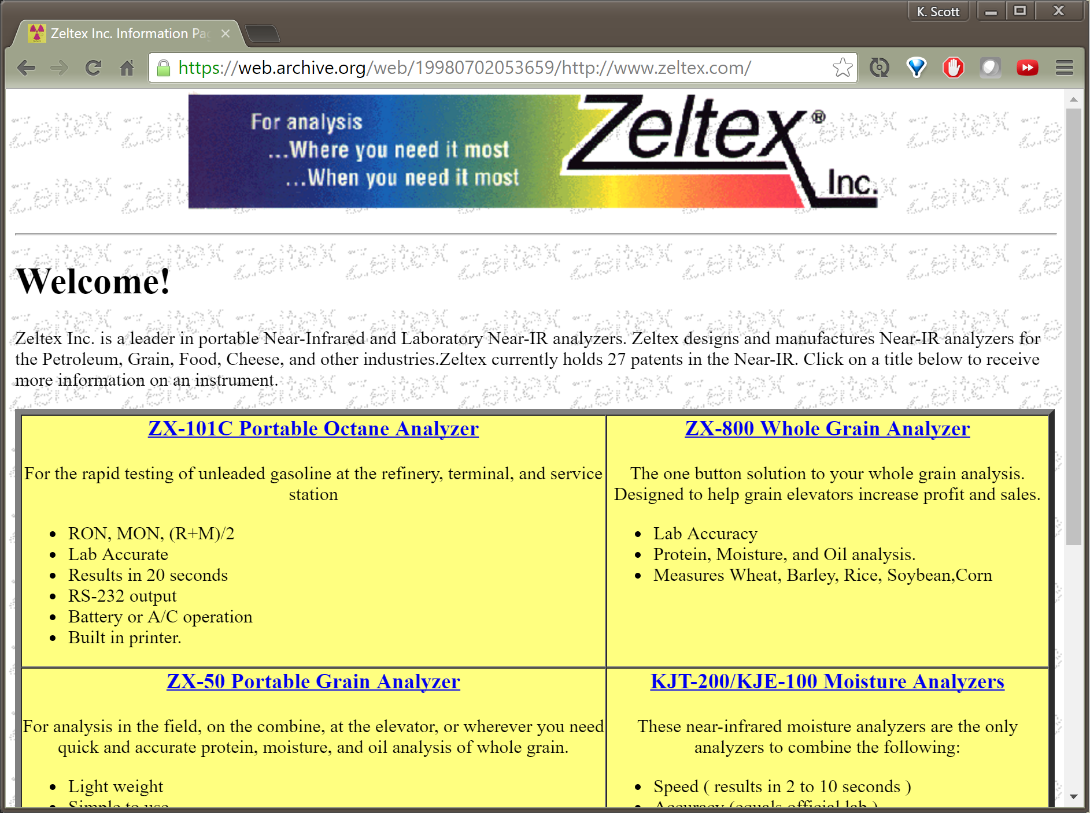
Notes:
I wrote my first web page in 1998. It was, like all web pages from 1995 hideous looking. It used tables for layout because the nightmare that is CSS was still a few years away.

Slide 2
Dear ${dietyName}, please give us:
Language features
Hardware APIs
DOM APIs
Just more APIs!
Layout features
Comis Sans Everywhere
Animations
An update to IE6
Giant complex frameworks

Slide 3


Slide 4

When the gods wish to punish us
they answer our prayers.
Oscar Wilde

Slide 5
All Standards and Drafts
Accessibility (All) Accessible Rich Internet Applications (WAI-ARIA) Audio Authoring Tool Accessibility Guidelines (ATAG) Automotive Best Practices for Authoring HTML CC/PP Content Transformation CSS CSS Mobile CSV on the Web Data on the Web DCCI Declarative Web Applications Device Description Repository Device Independence Authoring Digital Publishing DOM DOM events Efficient XML Interchange eGovernment Electronic Commerce Evaluation and Report Language (EARL) Geospatial Government Linked Data Graphics GRDDL Health Care and Life Sciences (Semantic Web) HTML HTML for User Agents HTTP IndieUI InkML Internationalization (All) Internationalization of Web Architecture Internationalization of Web Design and Applications Internationalization of Web Services Internationalization of XML Javascript APIs Linked Data MathML Media Access | Mobile Accessibility Mobile Web Applications Mobile Web Authoring Mobile Web for Social Development Multimodal Web Applications OWL Web Ontology Language P3P PICS Plugins PNG POWDER Privacy Provenance Quality Assurance (QA) Framework RDB2RDF RDF RDF Best Practices RDF Relationship to Other Formats RDF vocabularies RDFa RIF Rule Interchange Format Security for User Agents Security for Web Applications Semantic Annotation for WSDL and XML Schema Service Modeling Language (SML) SHACL SKOS SMIL SOAP Social Web SPARQL Stylesheets in XML SVG SVG Tiny Timed Text URI User Agent Accessibility Guidelines (UAAG) Voice Web and TV Web Annotation Web Applications Manifest Formats Web Architecture | Web Components Web Content Accessibility Guidelines (WCAG) Web Fonts Web IDL Web Payments Web Performance Web Real Time Communication Web Services Addressing Web Services Architecture Web Services Choreography Web Services Policy Web Services Resource Access WebCGM WICD Widgets WSDL XBL XForms XHTML 2 XHTML For Mobile XHTML Modularization XInclude XKMS XLink XML XML Base XML Canonicalization XML Design Techniques XML Encryption XML Events XML Fragments XML Pipeline (XProc) XML Relationship to other formats XML Schema XML Signature XML-binary Optimized Packaging xml:id XPath XPointer XQuery XSL-FO XSLT

Slide 6
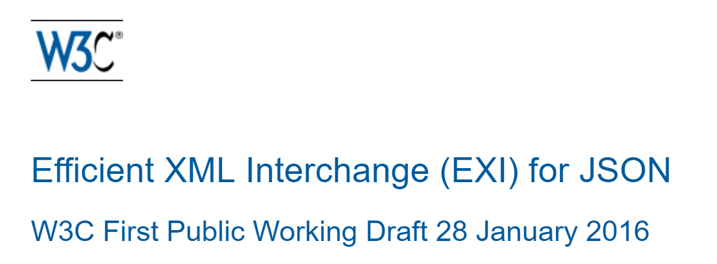
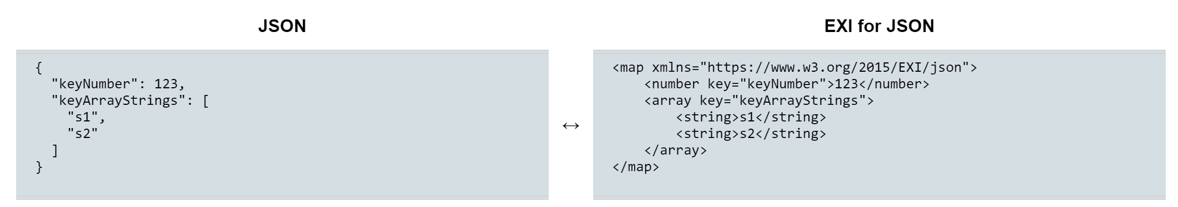

Slide 7

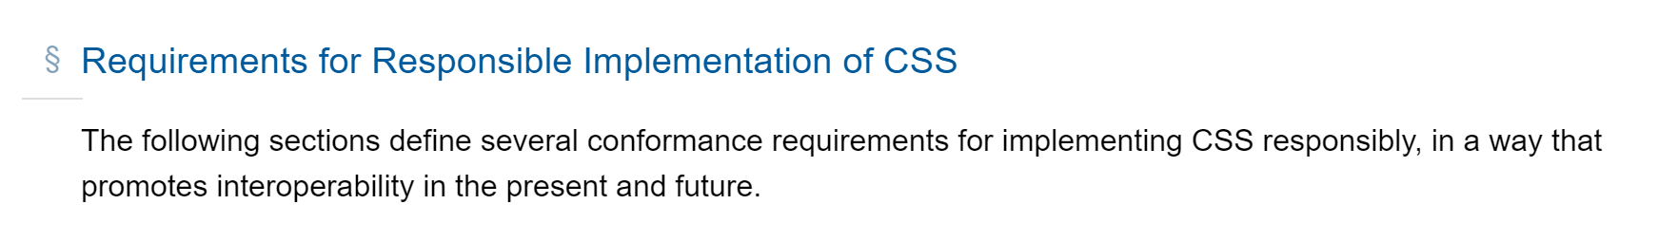
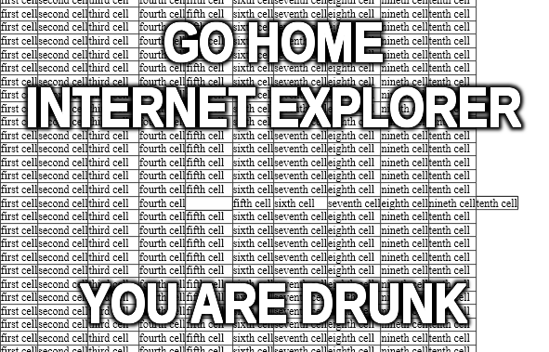



Slide 8

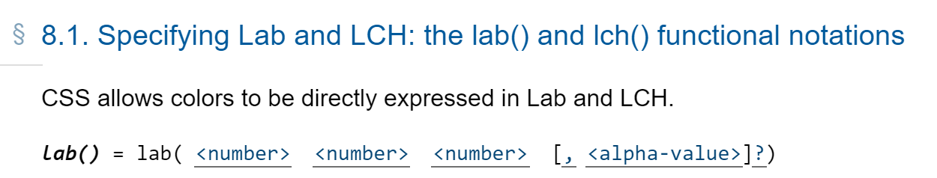
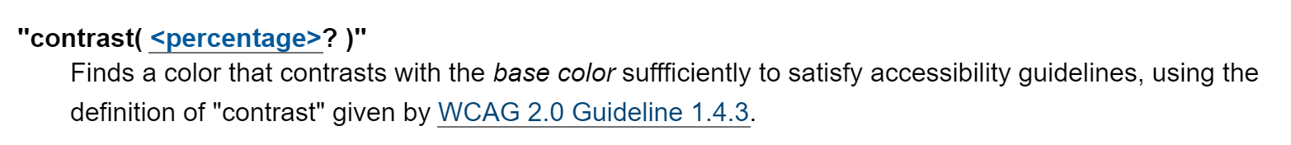

Slide 9

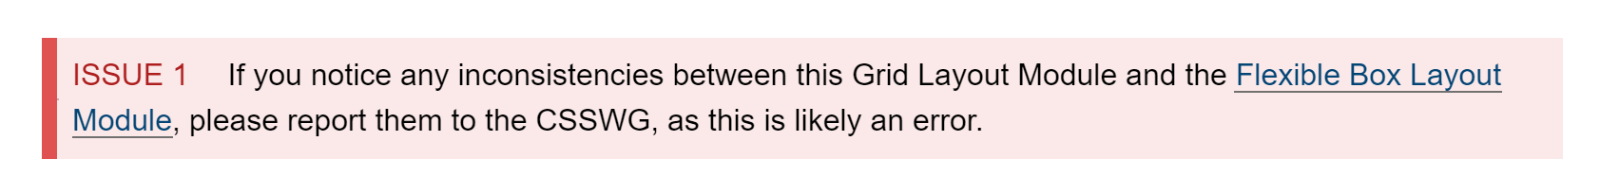
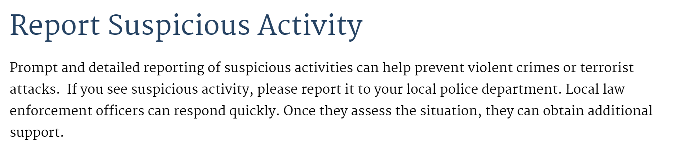


Slide 10

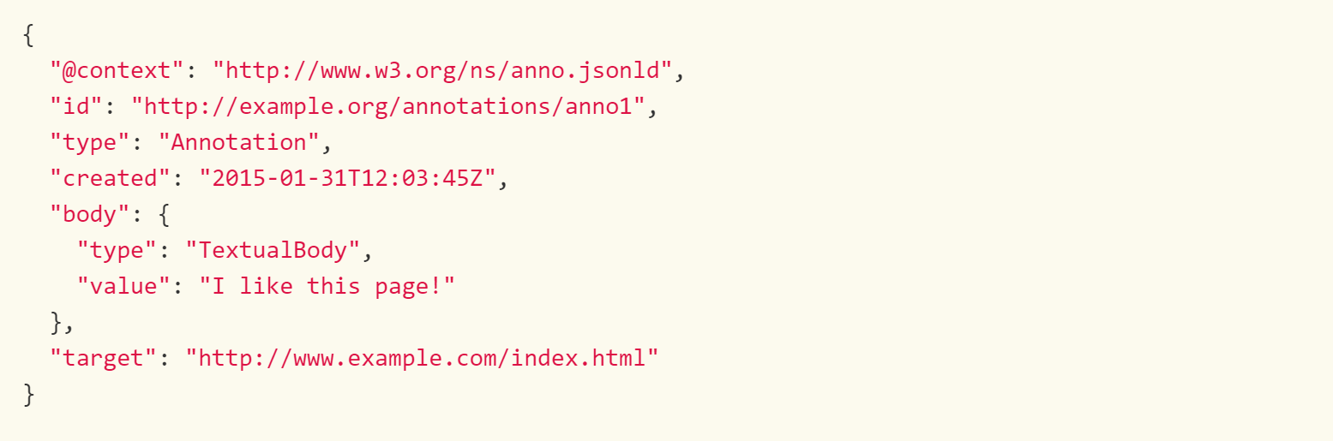


Slide 11





Slide 12



Slide 13
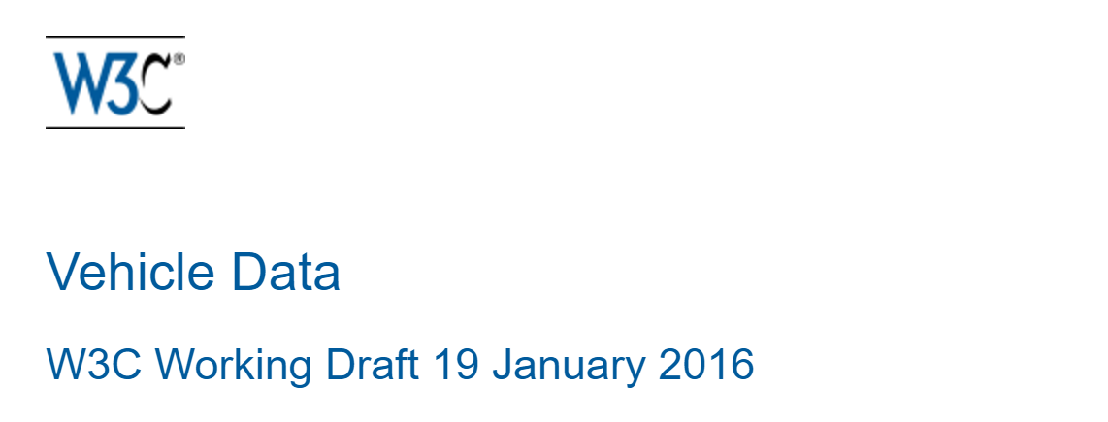
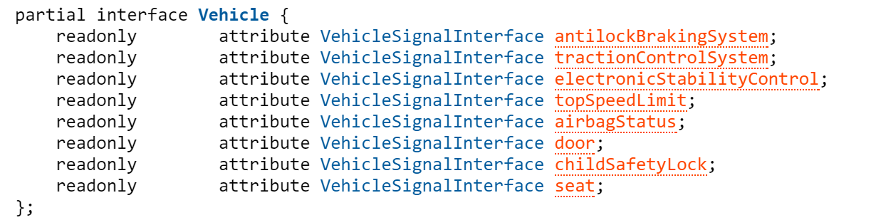
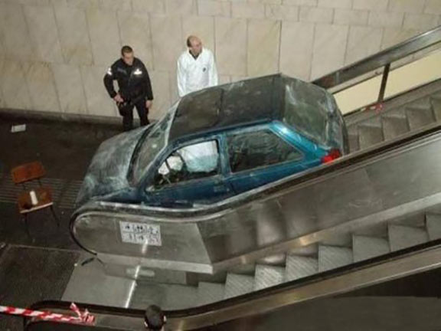

Slide 14




Slide 15
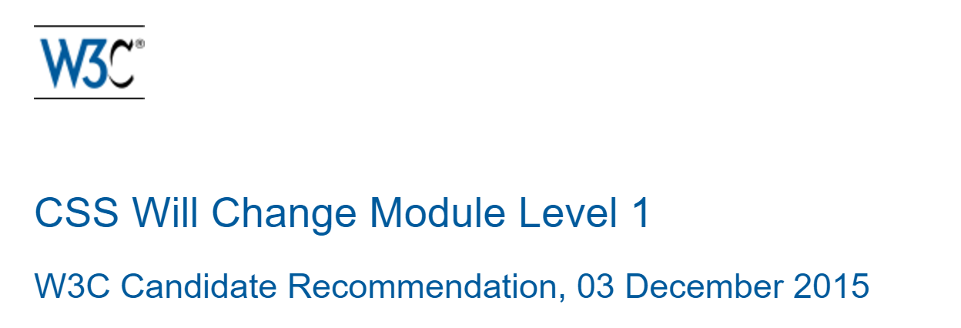
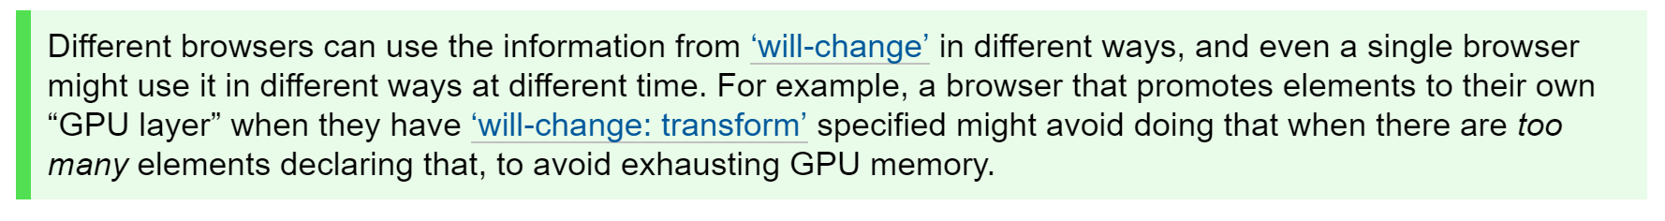


Slide 16
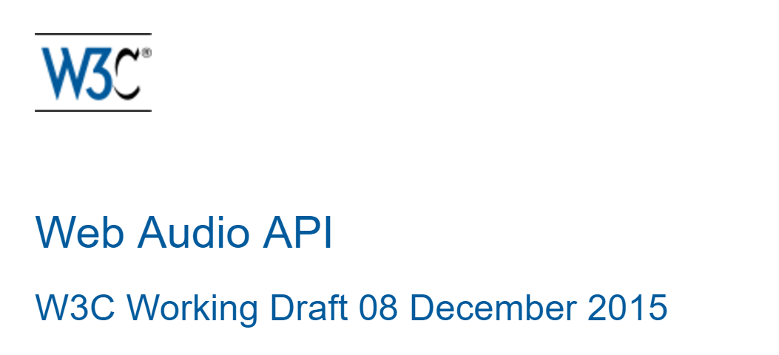
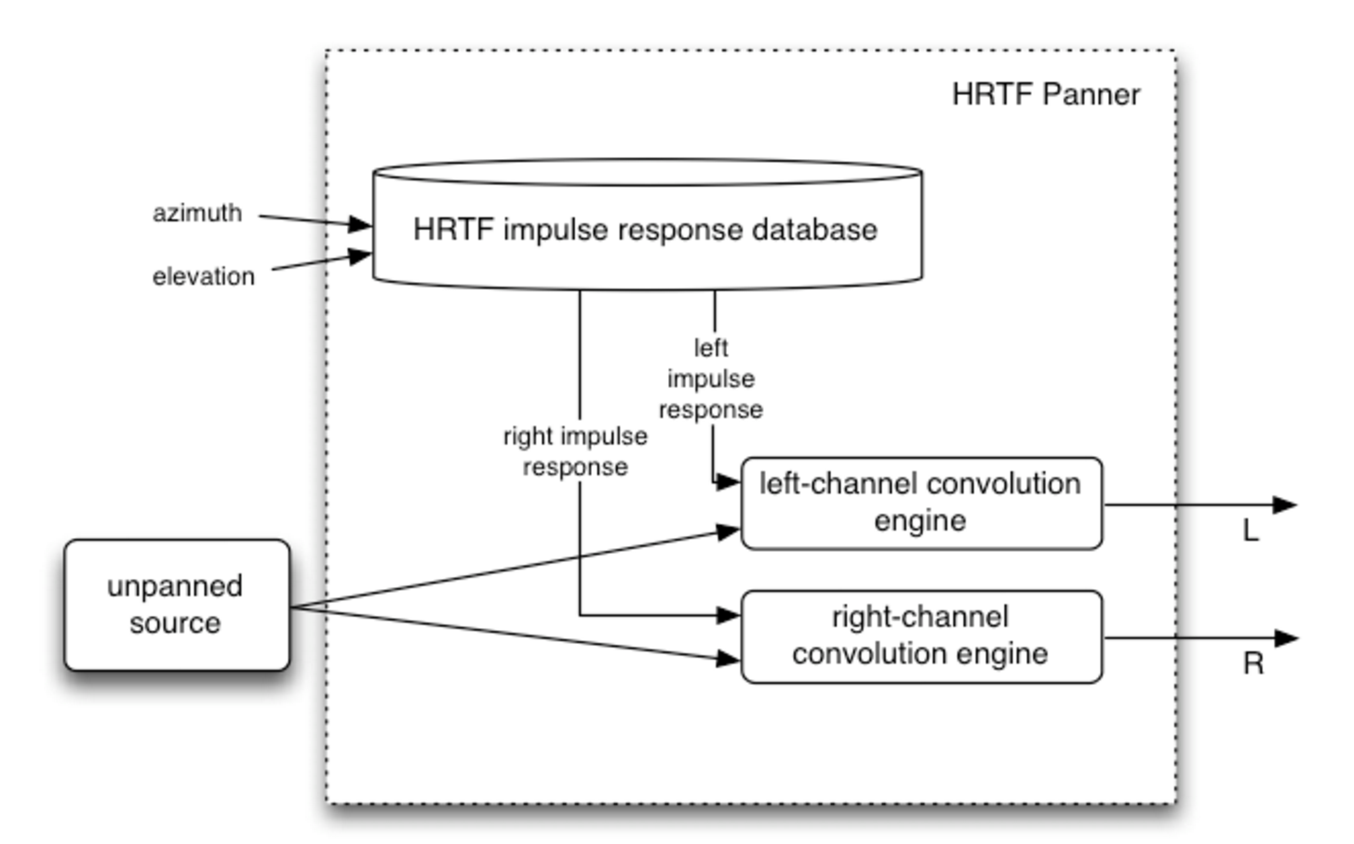


Slide 18
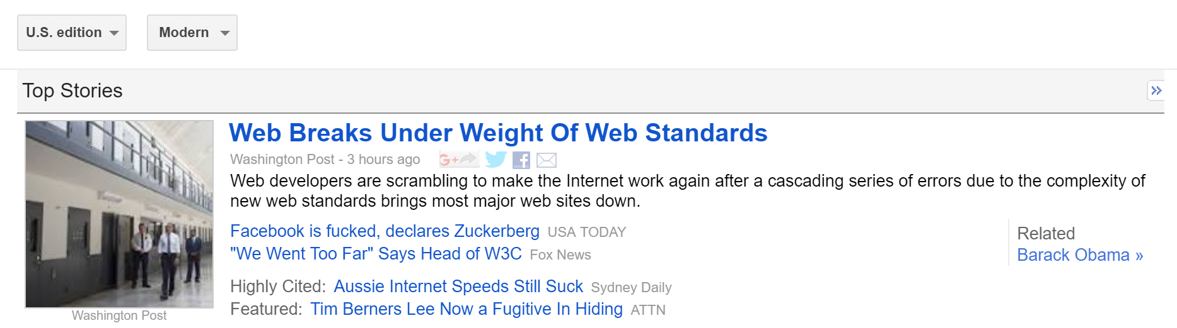

June 11, 2018

Slide 19

What Can We Do?
Only Servers
Can Render HTML
Use
tables
for layout
16 colors
are enough
New Standard?
Just Fuck It

Slide 20

Thanks!

